Slide 1

Anomaly Detection in Crowd
May - July 2024

Slide 2
Meet the Team

Slide 3
Agenda
Introduction
Project Timeline
Data Collection and Preprocessing
Exploratory Data Analysis (EDA) and Preliminary Analysis
Machine Learning Models for Anomaly Detection
Model Validation and Evaluation
Real-Time Anomaly Detection System
Insights and Applications
Challenges and Limitations
Future Work

Slide 4
Problem Statement
Understanding the problem - Why are we trying to do this?
How are we doing it? To develop a model using statistical and machine learning methods to detect anomalies in smartphone datasets, identifying unusual crowd behavior.
What is the application of these models?
To provide timely alerts to detect threats, ensure safety and improve event management, urban planning, and security monitoring.

Slide 5
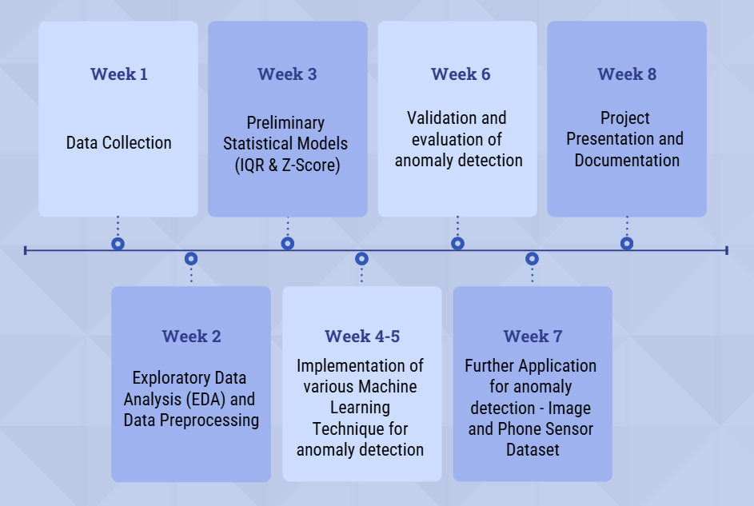
Week-wise Implementation Plan

Slide 6
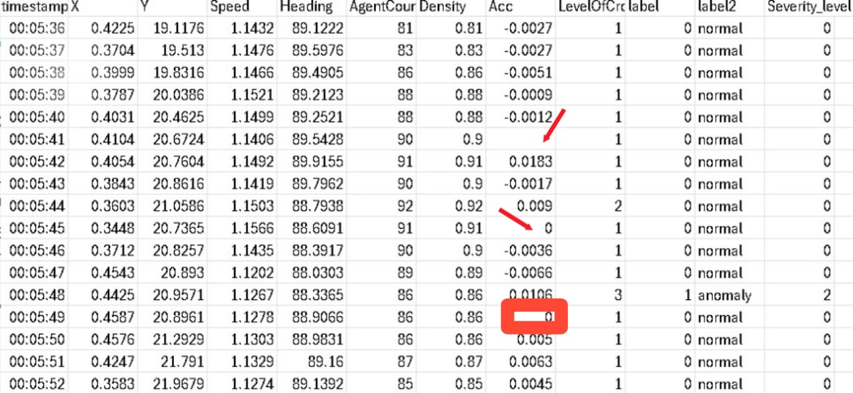
Data Collection & Pre-processing
Problem statement defines that smartphone dataset is crucial for analysis and it must contain features to detect activities. Hence the dataset collected from Kaggle.com
Analysing the dataset shows that there are
104 values are missing for the Acceleration
feature. These values should be treated with
other values.
Missing values treated by calculating mean value for distribution of acceleration feature and then all null values (missing values) replaced with mean value.
All numerical features are converted into same format i.e int data type.

Slide 7
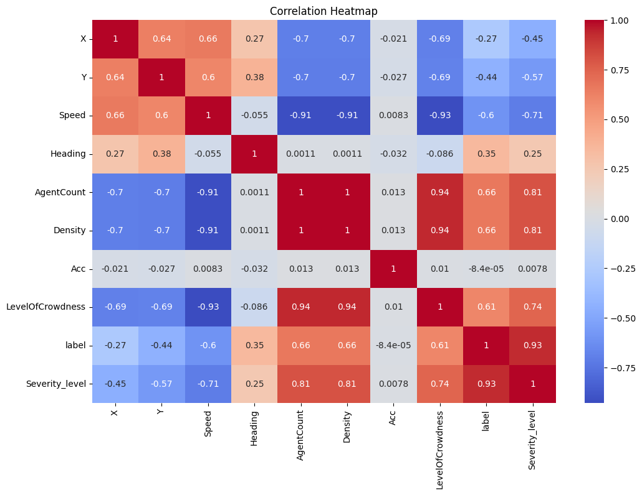
EDA
A correlation matrix was generated to display the correlation coefficients between pairs of numerical features.
Correlation: 'AgentCount' and 'Density' have a strong positive correlation and 'Speed' and 'Acc' have a weak positive correlation.

Slide 8
EDA
Heatmap - correlations
Box plots
Scatterplots

Slide 9
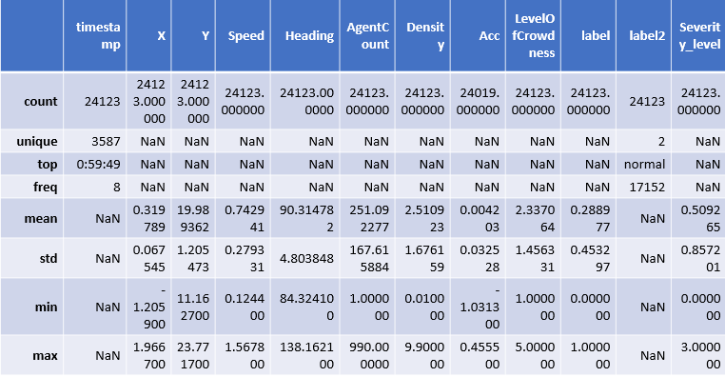
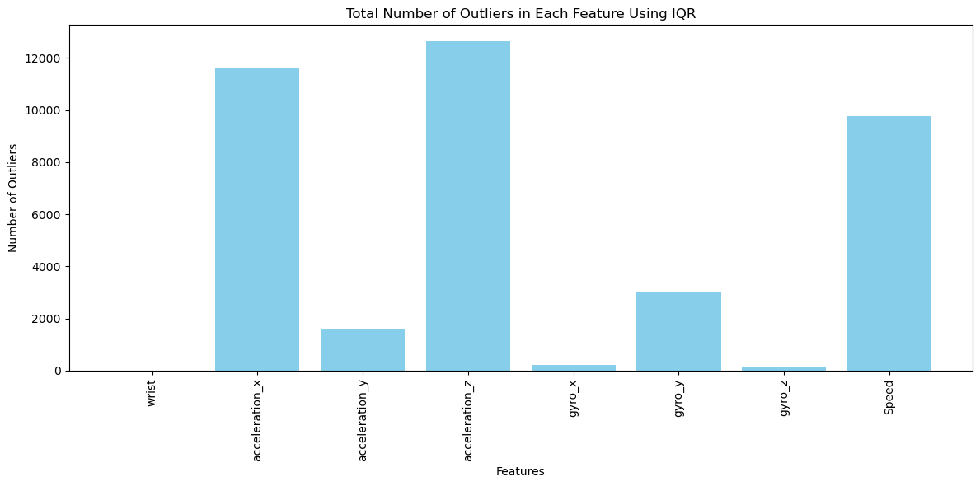
Initial Statistical Analysis
Initial statistical analysis for anomaly detection in smartphone datasets involves examining the data for any irregularities or outliers that may indicate unusual behavior or errors. This typically includes descriptive statistics to understand the central tendencies and dispersion (mean, median, mode, variance, standard deviation).

Slide 10
Model Building And Evaluation
Model Training :
- The model learns patterns from a labeled dataset, identifying normal and abnormal behaviors.
- It adjusts parameters to minimize prediction errors and better detect anomalies.
Model Testing:
- The model's performance is evaluated using unseen data.
- Predictions are compared with actual outcomes to assess accuracy.
Accuracy of Predictions: Evaluating the model results
- Measures the proportion of correct predictions out of all predictions.
- High accuracy indicates the model's good generalization ability.
- For imbalanced datasets, consider additional metrics like precision and recall.
Hyperparameter Tuning:
- Fine-tuning the model's parameters to increase accuracy and improve detection of anomalies.

Slide 11
Model Description
1)KNN:
KNN for anomaly detection identifies outliers by calculating the distance of each
data point to its 'k' nearest neighbors.
2)Isolation Forest:
Effective in detecting anomalies in high-dimensional datasets.
3)K-Means:
K-Means is a clustering algorithm used to group similar data points into clusters based on their features. For anomaly detection, the idea is to identify data points that do not fit well into any of the clusters.
4)Decision Tree:
.In the context of anomaly detection, decision trees can be used to classify data points as normal or anomalous.

Slide 12
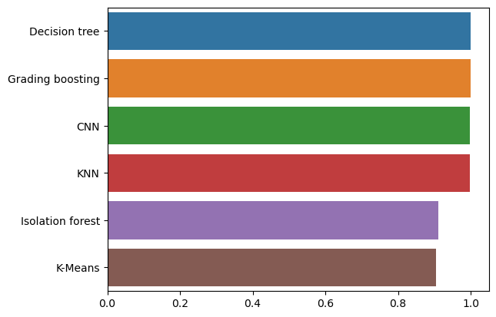
MODEL COMPARISON
Models | Accuracy | Precision | Recall | F1 Score
KNN | 0.99 | 0.99 | 0.99 | 0.99
Isolation Forest | 0.91 | 0.82 | 0.87 | 0.85
K_Means | 0.90 | 0.98 | 0.70 | 0.80
Decision Tree | 0.99 | 1.00 | 0.99 | 0.99
CNN | 0.99 | 0.99 | 0.99 | 0.99
Gradient Boosting | 0.99 | 0.98 | 0.97 | 0.97

Slide 13
Dataset Description
ucsd dataset
Put image

Slide 14
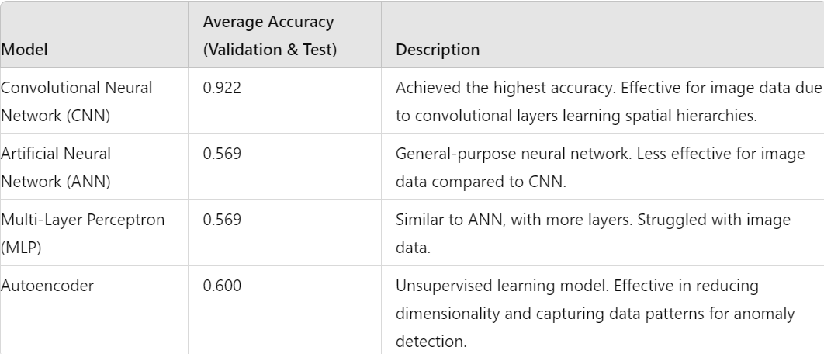
Anomaly Detection Model Accuracy Comparison on Image Dataset

Slide 15
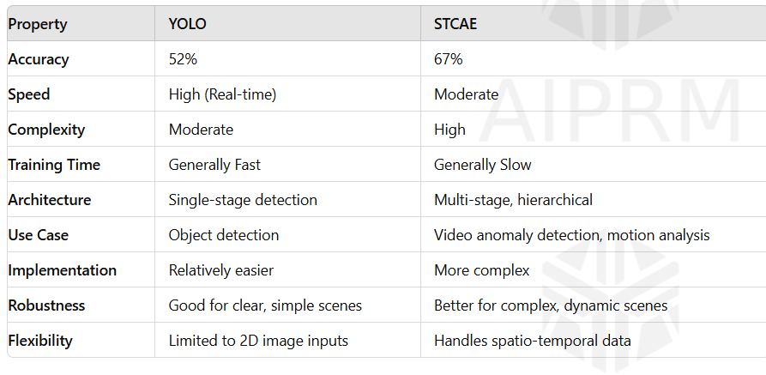
Application of Anomaly detection models on Images dataset:

Slide 16

Application of the model over Phone sensor Dataset
Lets Understand the dataset :-
Data was collected while driving the car on city roads in mild traffic. The parameters recorded are : Longitude, Latitude, Speed, Distance, Time, Acc X, Acc Y, Acc Z, Heading, gyro_x, gyro_y, gyro_z (Acc - Accelerometer, Gyro - Gyroscope).
Also another column present called 'label'. This column basically has two classes - '0' and '1'. '0' represents normal driving behavior while '1' represents aggressive driving behavior.
These datasets can be used for training machine learning models that classify a person's driving into normal or aggressive.
Feature selection focused on accelerometer (Acc X, Acc Y, Acc Z) and gyroscope (gyro_x, gyro_y, gyro_z) readings.
Kaggle
UI/UX of the application created:-

Slide 17
Anomaly Detection Model Accuracy Comparison on Phone sensor Dataset
Models | Accuracy | Precision | Recall | F1 score
KNN | 79.29 | 83.41 | 81.24 | 82.31
Isolation Forest | 77.26 | 86.53 | 73.01 | 79.204
SVM | 76.24 | 85.82 | 70.89 | 77.64
Decision Tree | 79.82 | 83.36 | 82.42 | 82.89
DBSCAN | 80.38 | 84.97 | 81.301 | 83.09

Slide 18
Anomaly Detection Model Accuracy Comparison on Phone sensor Dataset
Models | Accuracy | Precision | Recall | F1 score
KNN | 79.29 | 83.41 | 81.24 | 82.31
Isolation Forest | 77.26 | 86.53 | 73.01 | 79.204
SVM | 76.24 | 85.82 | 70.89 | 77.64
Decision Tree | 79.82 | 83.36 | 82.42 | 82.89
DBSCAN | 80.38 | 84.97 | 81.301 | 83.09

Slide 19
Future Scope
In real life, we need to have real time updates on anomaly detection among crowd. Therefore, we need to apply these machine learning techniques in real time videos. This can be done within applications or through API etc.
•API Development:
•Create an API to integrate the anomaly detection model with various applications, making it accessible for real-time use in industries like security surveillance and quality control.
•Advanced Architectures:
•Explore the use of more sophisticated neural network architectures, such as Variational Autoencoders (VAEs) or Generative Adversarial Networks (GANs), for improved anomaly detection capabilities.
•Cross-Domain Applications:
•Adapt and apply the CAE model to other anomaly detection tasks in fields like medical imaging, industrial automation, and financial fraud detection.

